Slide 1
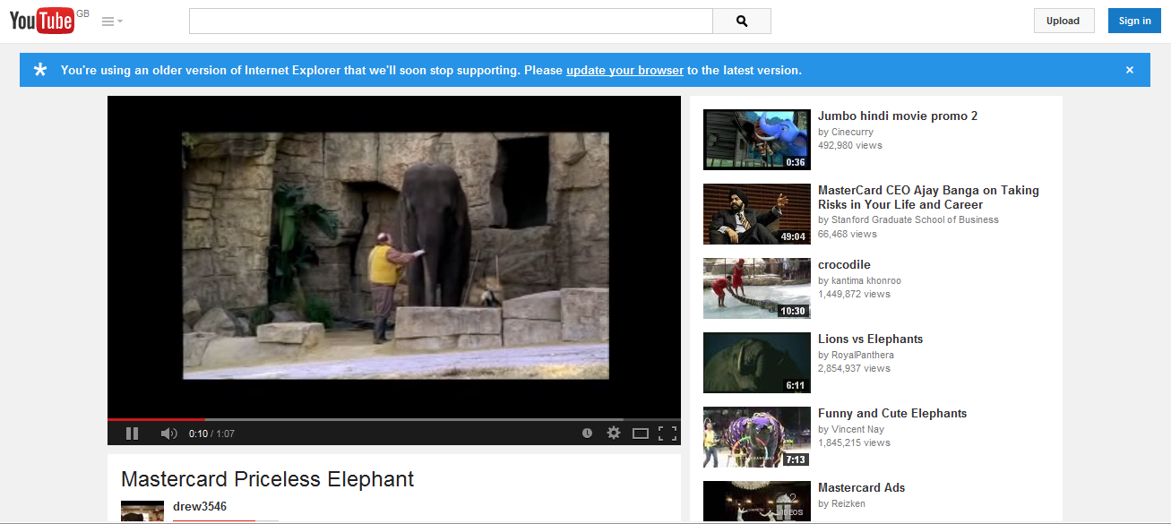
Watch this clip!
https://www.youtube.com/watch?v=WFNXwor69-U

Slide 2
A credit card is…
(Complete this sentence)

Slide 3
A credit card is a small plastic card issued by a bank, business, etc. allowing the holder to purchase goods or services on credit.

Slide 4
APR stands for…
(Complete this sentence)

Slide 5
APR stands for Annual Percentage Rate. APR means the total amount a loan will cost across a one year period. Expressed as a single percentage.

Slide 6



Card 1
Card 2
Card 3
Barclaycard
Platinum Credit Card
APR: 18.9%
Limit: £1,200
Capital One
Classic Platinum
APR: 29.8%
Limit: £1,500
Vanquis Visa Credit Card
APR: 39.9%
Limit: £3000
Your task
On each credit card you have to borrow £1200 .
you need to work how much you will need to repay over:
1 years
3 years
5 years
(Hint remember APR!)
Enter Answers on Next Slide

Slide 7
Card | APR % | 1 year | 3 years | 5 years
Card 1 | 18.9
Card 2 | 29.8
Card 3 | 39.9

Slide 8

Class discussion
“Are credit cards a good idea?”

Slide 9
Your task
To design your own Credit Card
Option 1
Design a credit card with high borrowing and high APR
Describe the advantages and disadvantages of your card
Option 2
Design a credit card with low borrowing and low APR
Describe the advantages and disadvantages of your card
Option | APR | Borrowing Limit | Advantages | Disadvantages

Slide 10
Let’s see your credit cards
?

